Slide 1
Squirrel Eats Squirrel: Description and Changes
Hoyt, Asa, Meridan, Sarina

Slide 2
Original Code
The original code is found in “Invent with python” under Squirrel eat squirrel, the name of our game.
Functionality:
Player can move at any direction using the arrow keys or using the WASD keys (‘w’ = up, ‘a’ = left, ‘s’ = down, ‘d’ = right)
Main goal of the game is to become Omega Squirrel (largest squirrel) in the shortest amount of time
You achieve this by eating squirrels that are smaller and avoid the ones that are bigger
Collide with the bigger ones, you lose a life

Slide 3
Changes
List of Changes:
Music
Added non-player squirrels with power-ups
Time/Best time
New best record system
Sound effects
Debuffs

Slide 4
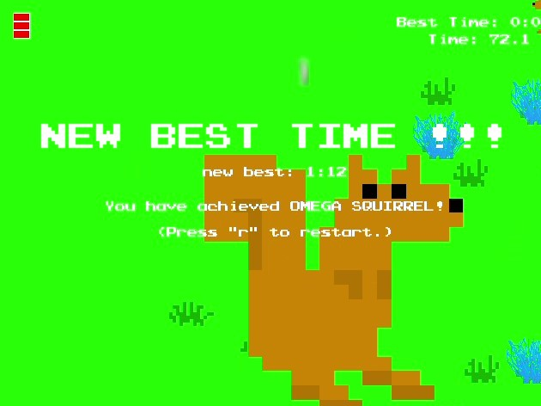
Music, Sound effects, and Best time System
Music done through pygame mixer and music module.
3 songs with a random chance to play.
Sound effects for various game actions i.e (moving).
Best time system done through a file writers.
Display the fastest time to beat the game.

Slide 5
Functionality
Plus the functionality from the original code, there are some extras we added in:
3 music soundtracks that have set probabilities of change after re-opening the game
If the player’s squirrel grows to reach the Omega squirrel size, a best time is saved.
There are different types of non-player squirrels:
Regular enemy squirrel: The player loses one life when being eaten by a larger squirrel
Drunk squirrel
Ghost squirrel
Vampire squirrel
Unicorn squirrel
Chernobyl squirrel
Einstein squirrel
Note: There are different probabilities for each of these squirrels to spawn

Slide 6

The Chernobyl Squirrel
The squirrel looks fine… I think.
…bruh, its melting
Functionality: The player squirrel explodes. It’s game over

Slide 7

The Unicorn Squirrel
Unicorns are just cooler rhinos. Change my mind
Functionality: If the player’s squirrel is larger, they regain one life and the game goes into disco mode for a short amount of time. If not, it behaves as a normal squirrel

Slide 8

The Einstein Squirrel
Based on realization that professors are way smarter than you.
Functionality: Plays unique sound effect on collision, upon eating grants player +1 health

Slide 9

The Ghost Squirrel
I think this squirrel exists…
Functionality: The player is scared frozen for a short amount of time

Slide 10
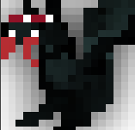
The Vampire Squirrel
Does blood taste good? I should try it out - Vampire Squirrel
Functionality: This squirrel has a randomly accelerated speed

Slide 11
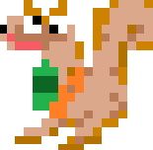
The Drunk Squirrel
Don’t drink and Drive, kids!
Functionality: The player’s controls are inverted for a short amount of time

Slide 12
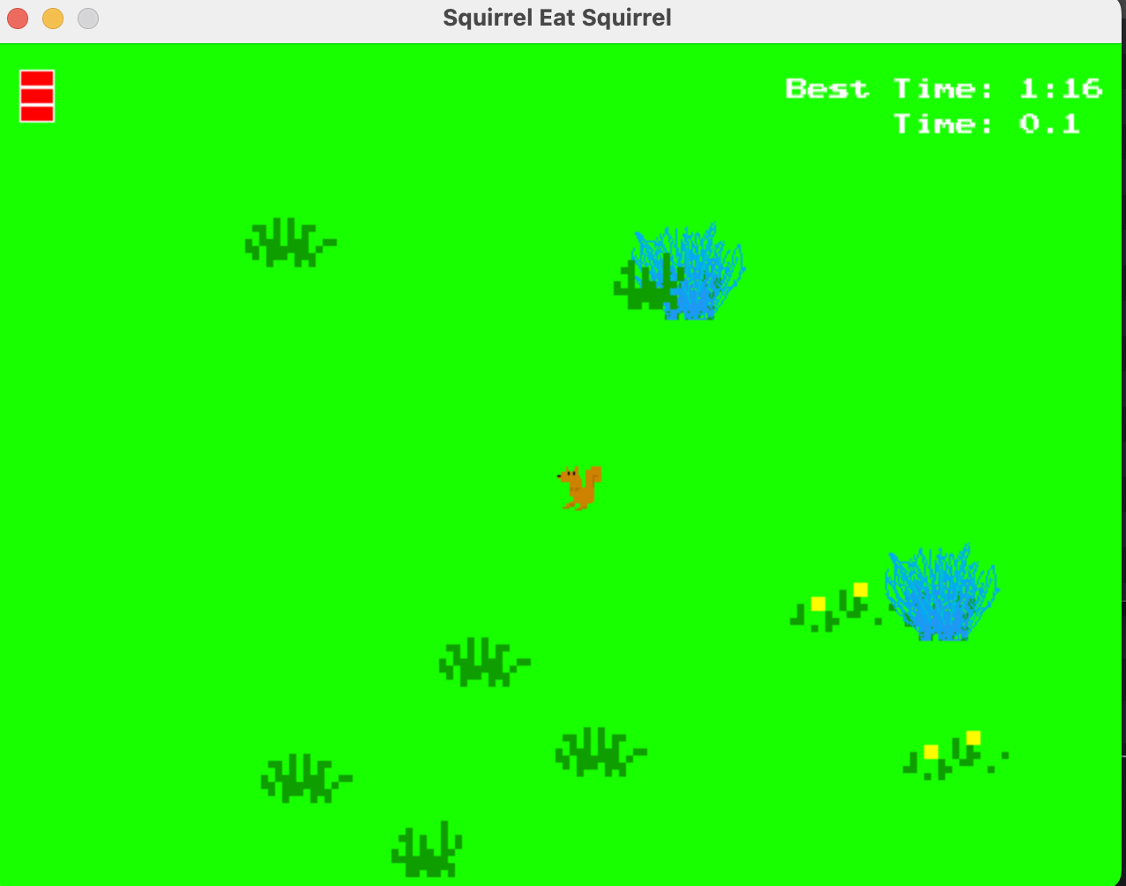
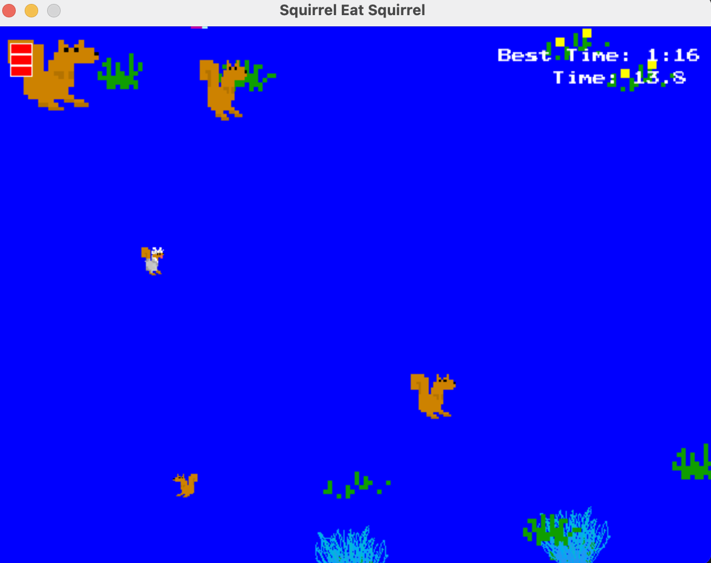
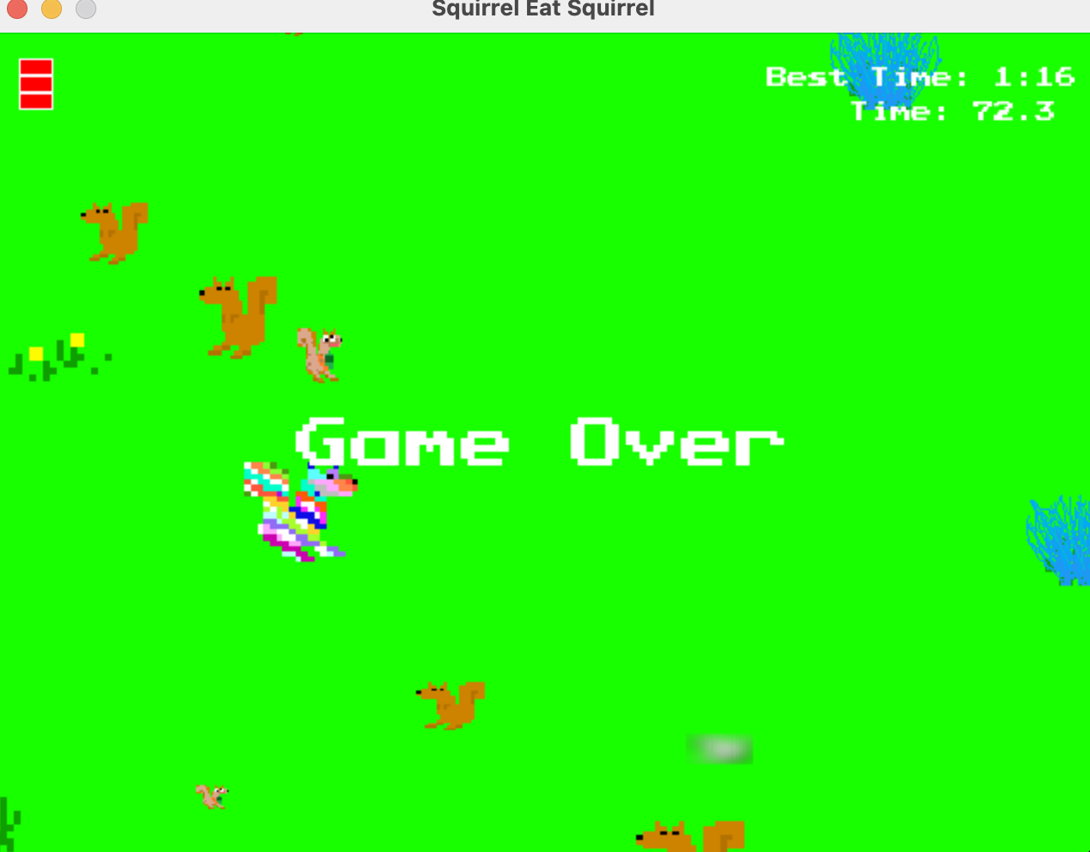
Demo

Slide 13
Sources
Sweigart, Al. “Chapter 8 – Squirrel Eat Squirrel.” Invent with Python, https://inventwithpython.com/pygame/chapter8.html.
Sweigart, Al. Making Games with Python & Pygame, https://inventwithpython.com/pygame/.
YouTube, YouTube, 21 Jan. 2022, https://www.youtube.com/watch?v=A3-CDBglkjs. Accessed 5 Dec. 2022.
YouTube, YouTube, 25 Sept. 2016, https://www.youtube.com/watch?v=6hURqvyTBvA. Accessed 5 Dec. 2022.
20, March, director. YourClassical from American Public Media and Minnesota Public Radio, Minnesota Public Radio, 20 Mar. 2017, https://www.yourclassical.org/episode/2017/03/20/daily-download-antonio-vivaldi--the-4-seasons-spring-i-allegro. Accessed 5 Dec. 2022.
ZapSplat, 16 Nov. 2022, https://www.zapsplat.com/. Accessed 5 Dec. 2022.
21, June, director. YourClassical from American Public Media and Minnesota Public Radio, Minnesota Public Radio, 21 June 2016, https://www.yourclassical.org/episode/2016/06/21/daily-download-edvard-grieg--peer-gynt-suite-no-1-morning-mood. Accessed 5 Dec. 2022.
Used Pixilart for visual upgrades: Pixilart - Free online pixel art drawing tool

